Slide 1
Campus Ministry Student Forum
GUSA Financial Appropriations Budget Summit FY20

Slide 2
TOTAL REQUEST:
$20,462
Notes:
$16,565

Slide 3
Breakdown by Organization
Muslim Student Association: $7,150
Jewish Student Association: $540
Hindu Student Association: $4,518
Orthodox Christian Fellowship: $3,040
Buddhist Student Association: $3,714
Women in Faith (NCD): $1,500
Notes:
MSA: Attendance is rapidly increasing, we are hosting more interreligious events, and Ramadan next year will overlap with more of the school year than it has in almost a decade.
JSA: We requested slightly more because this year we have not had any board bonding events and we hope that next year’s board can have some. We also added a Hanukkah Party into our budget which we have never had before. A lot of our money goes into Bagel brunches which cost around $300-$320 per event, so we want to ensure that next year we will not have a problem having them.
HSA: Our organization needs a robust budget in order to sustain its event-based infrastructure and cater to the large numbers of students who are in attendance to celebrate these religious holidays.
OCF: Not asking for any additional funding
BuSA: The first is that our organization has continued to expand throughout the past year, with the creation of new board positions and higher turnout both at weekly meditations and more specialized programming. In order to offer adequate programming to people of every tradition, we will need more flexibility financially.
The second reason is that we are attempting to forge connections with temples in the DC area, culminating in the monthly visits by a nun from the US Zen institute. We intend to increase the amount of temple visits and adequately advertise and prepare for visits by the nun.
WiF: Needs initial funding

Slide 4
Reasons for Increase
Increased membership
Need for larger spaces which are more expensive
Higher food costs, especially when accommodating religious dietary restrictions
Increased need due to hate crimes
The Hindu, Jewish and Muslim communities, in particular, have faced an increasing number of hate crimes
The HSA, JSA and MSA provide space for students to process events and find community and support
Need to engage around intra-religious tensions and division
Examples include recent split in the Russian Orthodox Church, engaging ethnic Buddhist and diverse political opinions within traditions
Diversifying programing
Including Temple Visits for BuSA, interfaith programming, Hannukah activities, Ramadan services and events reaching previously unengaged students
Club Addition
The Women in Faith (WiF) organization was accepted into the new club development process

Slide 5
Budgeting Process
Round 1: Treasurers of each organization complete a preliminary budget from a template created by the CMSF Treasurer
Round 2: Each treasurer meets with the CMSF treasurer to discuss changes ensuring ethical and essential spending
Round 3: Treasurers submit their update budgets to the CMSF treasurer. This process continues until the CMSF Treasurer and President determine the budgets are complete.
Round 4: The organizational budgets and contributions from the chaplaincies are combined to determine the total request

Slide 6
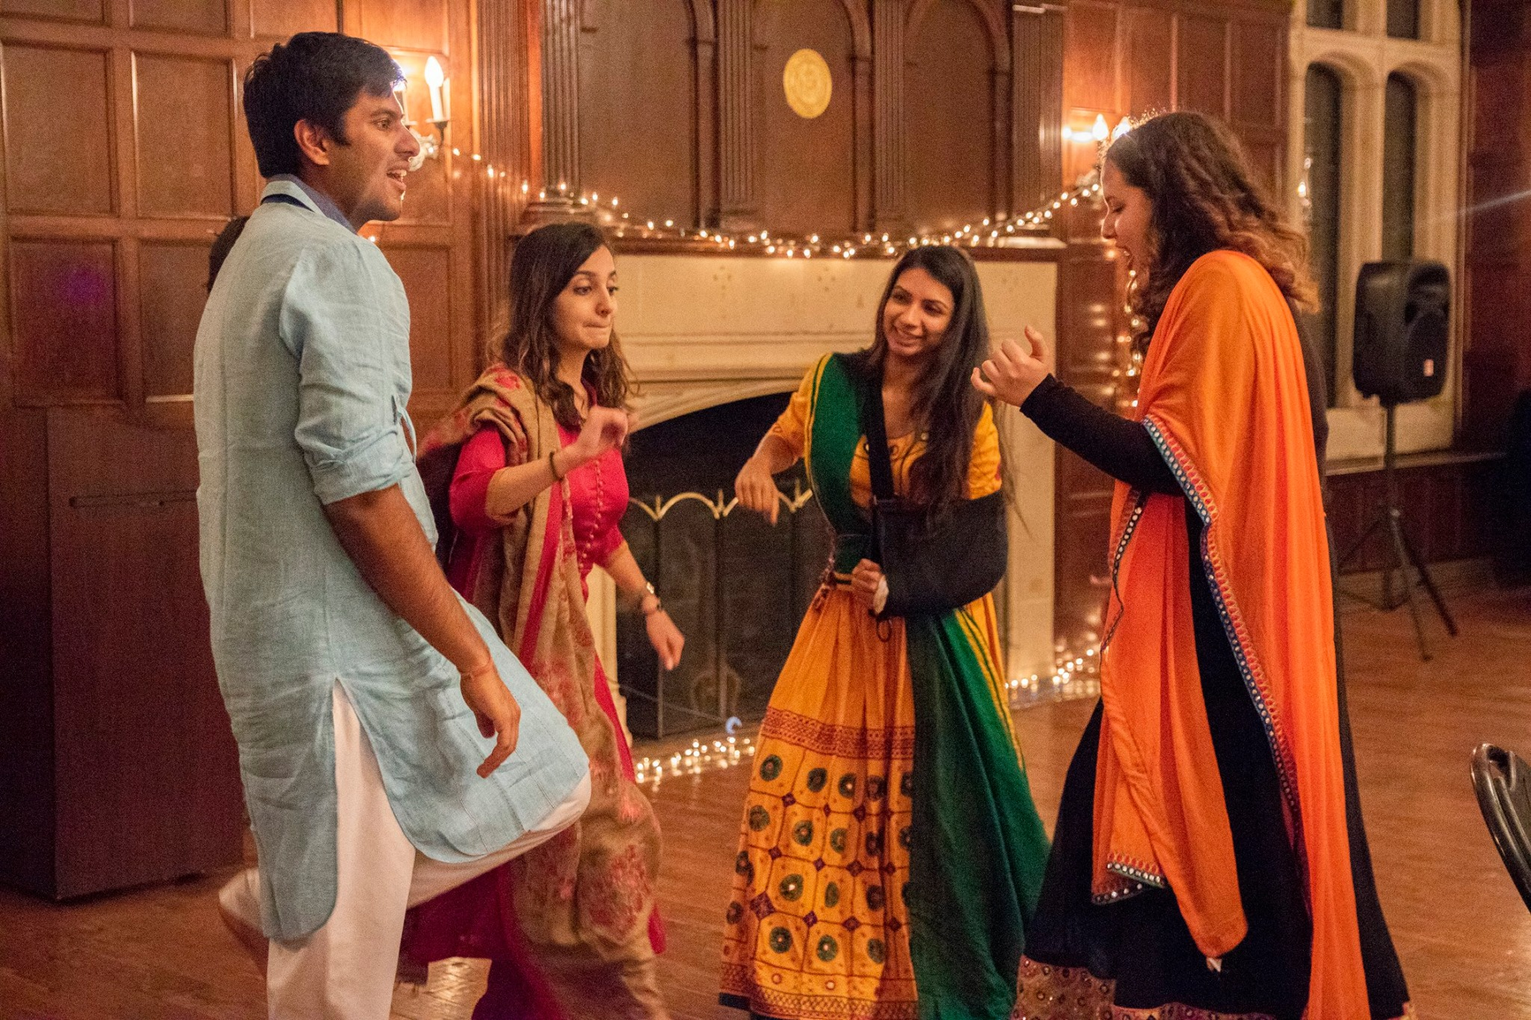
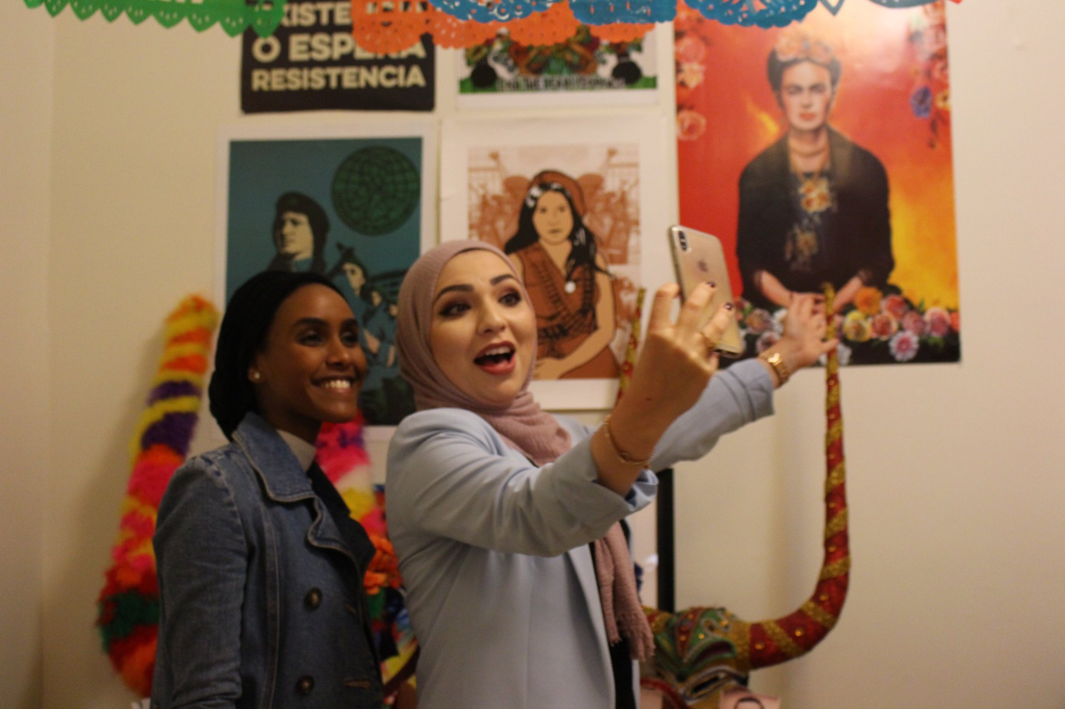
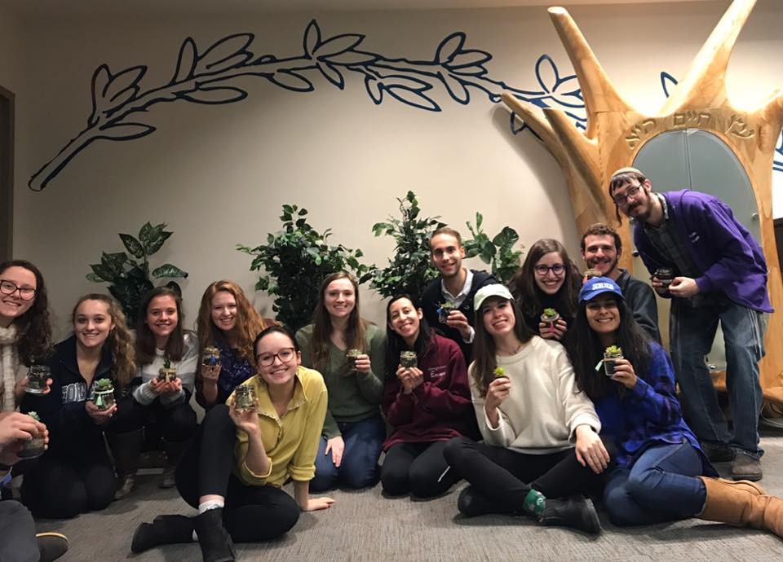
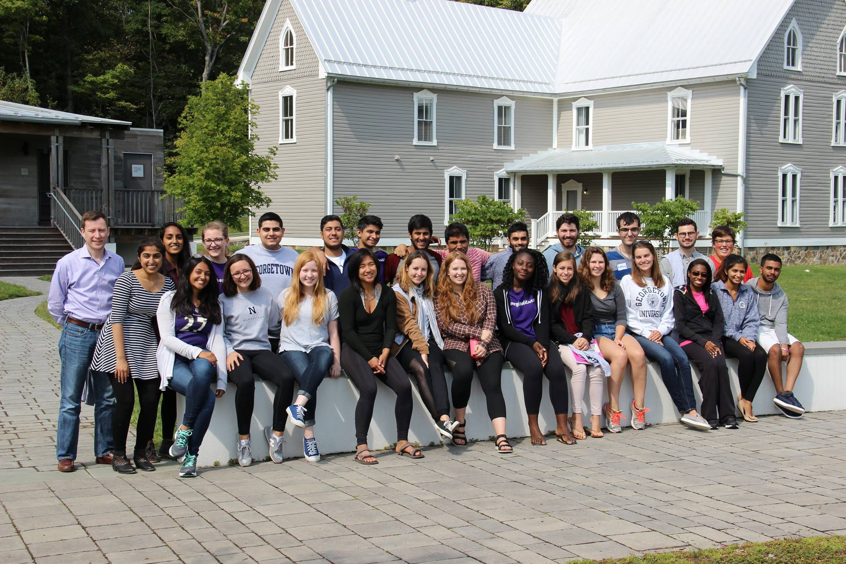
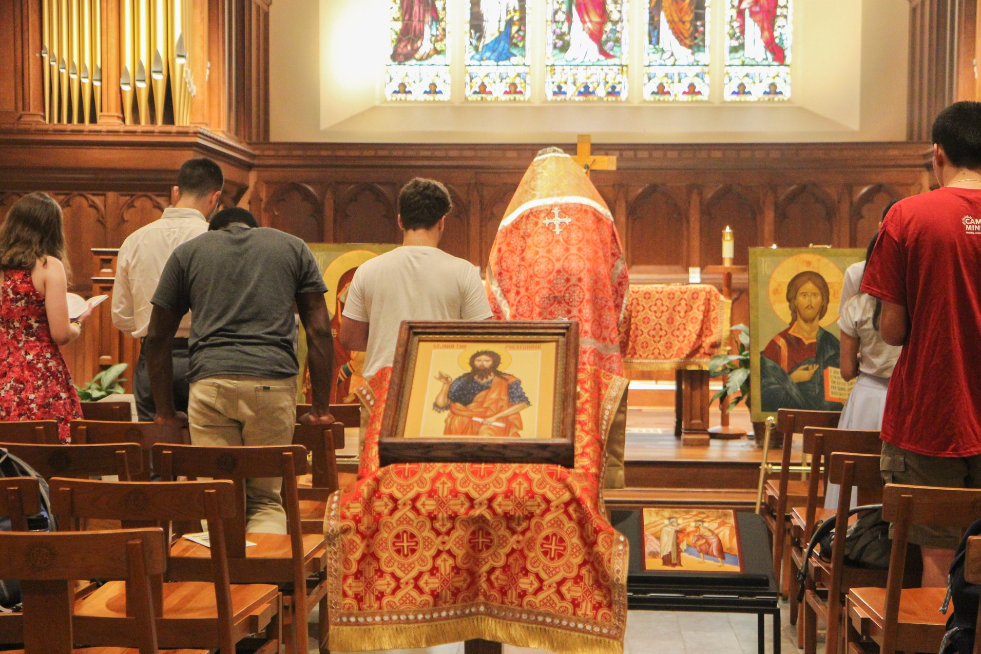
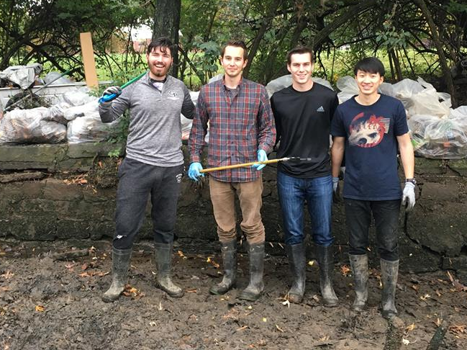
Why CMSF Matters

